Slide 1
Plant Disease Segmentation
Group 2

Slide 2
Contribution Details
ID | NAME | CONTRIBUTION
21201222 | Most. Sumaiya Haque Subah | Data Pre-processing
21201546 | Rashik Bin Haider | Data Pre-processing
21201325 | Naomi Afrin Jalil | U-Net Architecture
21101298 | ANIKA ISLAM | Evaluation Metric

Slide 3
Dataset Descriptions
Name : PlantSeg
Total images : 11,458 images
Total segmentation masks : 11,458 images
Number of plant types included : 34 (categories : staple crop, profit crop, fruits & vegetables)
Diseases present : 115
Processing already implemented : Image Acquisition, Data Cleaning & Segmentation annotations

Slide 4
Splitting Training & Validation data
Training =
7330 images
Total images = 11,458 images
Training data = 9163
Validation = 1833 images
Testing data = 2295 images

Slide 5
Image Preprocessing
Image Resize
Conversion into numpy array
Images : Convert from grayscale to RGB
Masks : Convert from RGB to grayscale

Slide 6
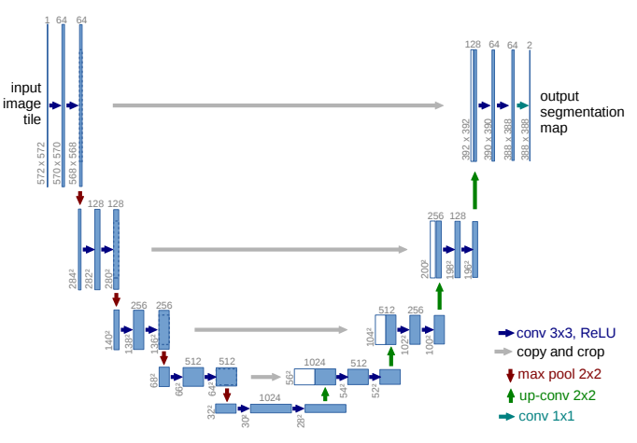
U-Net Architecture

Slide 7
U-Net
Input image size :- 128 x 128
Contraction layer (encoder) :- 64 → 128 → 256 → 512 → 1024
Expansion layer (decoder) :- 1024 → 512 → 256 → 128 → 64
Activation function :- ReLu
Optimiser :- Adam [for updating the model based on the loss.]
Binary Cross Entropy Loss:- Measures performance on binary segmentation.

Slide 8
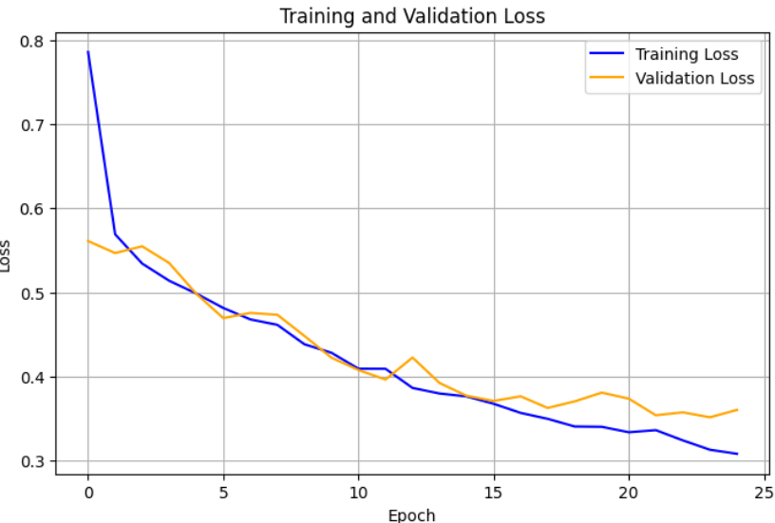
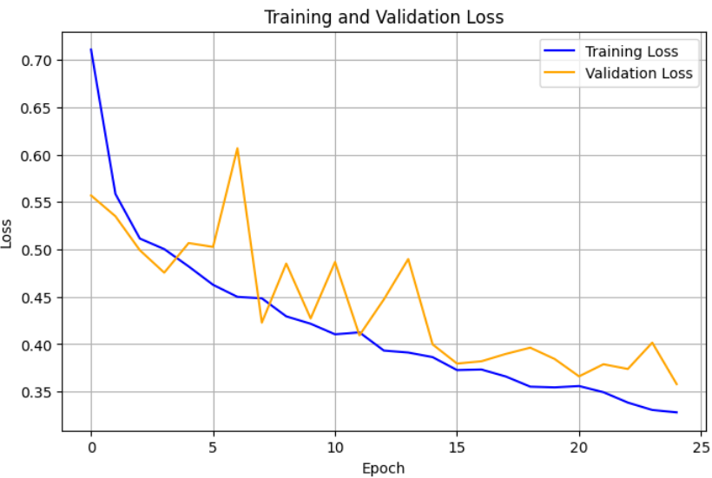
Loss v/s Epoch Plot
Batch size = 64
Epoch = 25
Batch size = 32
Epoch = 25

Slide 9
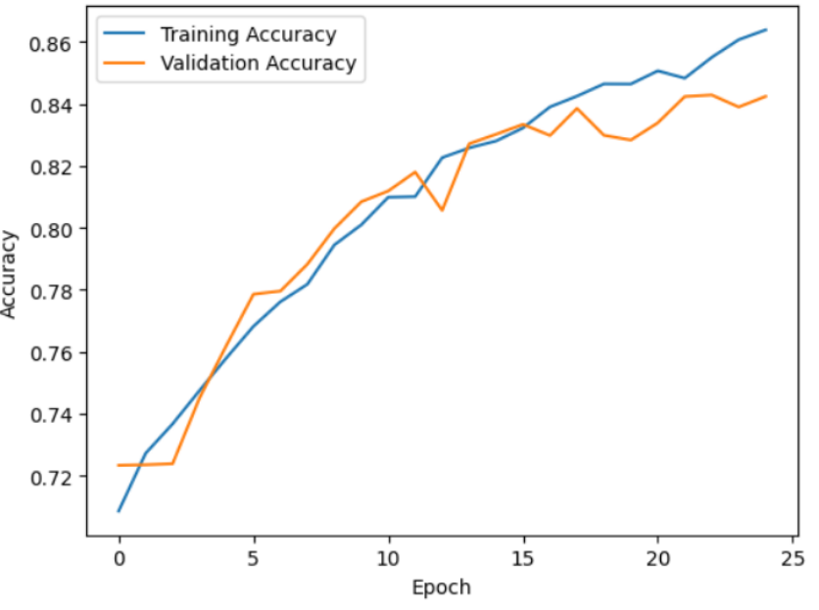
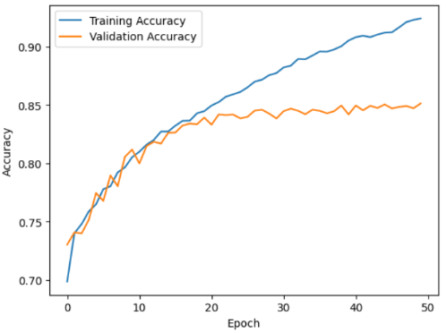
Accuracy v/s Epoch Plot (using batch size = 64)
Epoch = 25
Epoch = 50

Slide 10
Accuracy Results
With batch size = 64, epoch = 25
Training accuracy = 86.53%
Validation accuracy = 84.24%
Testing accuracy = 84.25%

Slide 11
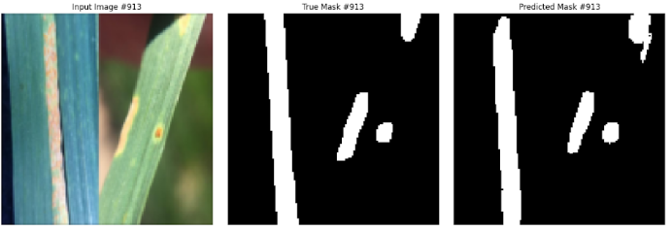
Good Segmentation
Epoch = 25

Slide 12
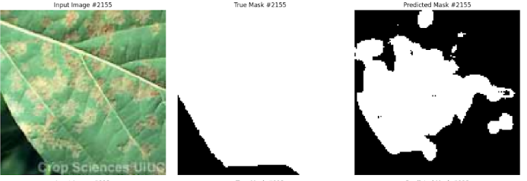
Bad Segmentation
Epoch = 25

Slide 13

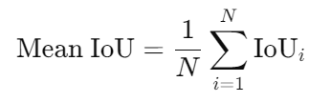
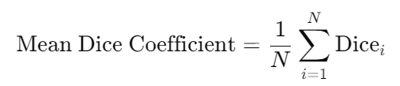

Evaluation Metrics
Mean IoU
Mean Dice Coefficient
Pixel Accuracy

Slide 14
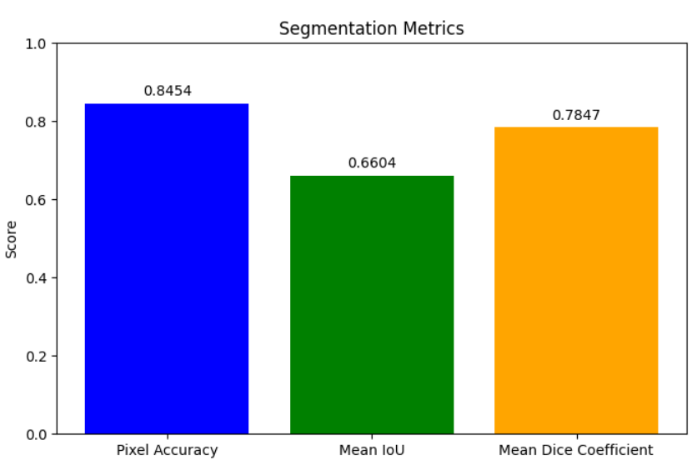
Evaluation Metric Results
Epoch = 25

Slide 15
Thank You
U-Net Architecture Model Reference :- https://arxiv.org/pdf/1505.04597
Results Directory :- https://drive.google.com/drive/folders/1KRgdwBMCikg1QkRusC-TixWgrqxAubWP

